Slide 1
Several Scala design patterns
Vitaliy Savkin
Software Engineer

Slide 2
Topic of presentation
Design pattern is a general reusable solution to a commonly occurring problem within a given context in software design.
Design patterns reside in the domain of modules and interconnections.
Architectural patterns
Design patterns
Algorithms & code style guides

Slide 3
Features of Scala influencing the Design
Functions as first-class citizens
Advanced OO techniques
Strong type system
Encouraged immutability

Slide 4
FUNCTIONS
Several Scala design patterns

Slide 5
Functions syntax
// lambda
val inc = (x: Int) => x + 1
val inc = (_: Int) + 1
val inc: Int => Int = _ + 1
// closures
val const = 10
val addConst = (x: Int) => x + const
// method
class Foo { def inc(i: Int): Int = i + 1 }
// methods as functions
val foo = new Foo
val f: Int => Int = foo.inc _

Slide 6
Functions syntax
// partially defined function
val fac: PartialFunction[Int, Int] = {
case 0 | 1 => 1
case n if n > 1 => n * fac(n - 1)
}
// curried function
val add = (x: Int) => (y: Int) => x + y
val inc = add(1)
// high-order function
val applyToDoubled = (f: Int => Int) => (x: Int) => f(2 * x)
val incDoubled: Int => Int = applyToDoubled(inc)
incDoubled(10) // 21

Slide 7
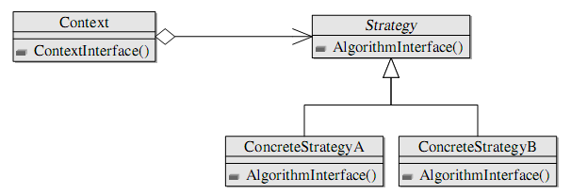
Strategy
Strategy pattern
defines a family of algorithms
encapsulates each algorithm
makes the algorithms interchangeable within that family

Slide 8
Strategy
class Layout(layoutStrategy: (Point, Block) => Point)
val globalContext: Context = ...
// Place extra data using currying
val horizontal: Context => (Point, Block) => Point
val vertical: Context => (Point, Block) => Point
val layout = new Layout(horizontal(globalContext))
// Place extra data using closures:
// use globalContext here
val horizontal: (Point, Block) => Point = ...
val vertical: (Point, Block) => Point = ...
val layout = new Layout(horizontal)

Slide 9
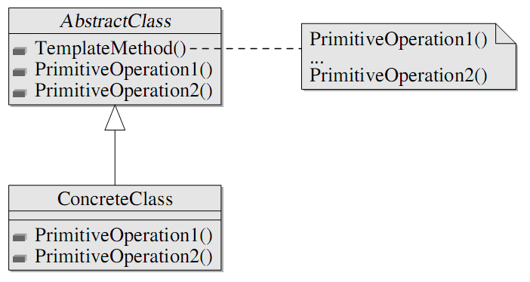
Template Method
Template method pattern
defines the program skeleton of an algorithm in a method, which defers some steps to subclasses

Slide 10
Template Method
class GameState { def winner(): Int }
class Game(initialState: GameState,
endOfGame: GameState => Boolean,
makePlay: (GameState, Int) => GameState){
def playGame(playersCount: Int): Int = {
var state = initialState
var i = 0
while(!endOfGame(state)){
state = makePlay(state, i)
i = (i + 1) % playersCount
}
state.winner()
}
}

Slide 11
Template Method
class GameRules(endOfGame: GameState => Boolean,
makePlay: (GameState, Int) => GameState,
playersCount: Int)
@tailrec
def playGame(gameRules: GameRules,
state: GameState,
currPlayer: Int) =
if(gameRules.endOfGame(state)) state.winner()
else playGame(gameRules,
gameRules.makePlay(state, currPlayer),
(currPlayer + 1) % gameRules.playersCount)

Slide 12
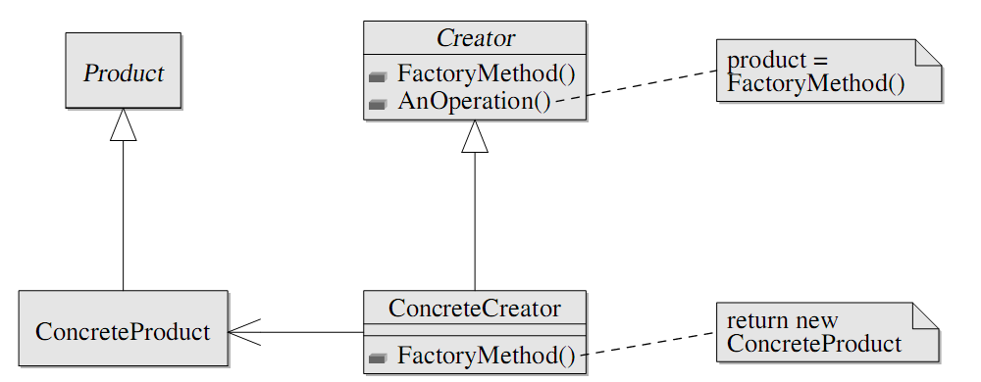
Factory Method
Factory method pattern
deals with the problem of creating objects without specifying the exact class of object that will be created

Slide 13
Factory Method
trait Room
trait MagicRoom extends Room
trait OrdinaryRoom extends Room
trait Treasure
class Maze(makeRoom: Treasure => Room){
val room1 = makeRoom(randomTreasure())
val room2 = makeRoom(randomTreasure())
room1.connect(room2)
rooms.add(room1, room2)
def randomTreasure(): Treasure = ...
}

Slide 14
Factory Method
val ordinaryRoom: Color => Treasure => OrdinaryRoom = ...
val magicRoom: Treasure => MagicRoom = ...
val greenMaze = new Maze(ordinaryRoom(Color.Green))
val magicMaze = new Maze(magicRoom)
// Note that Treasure => MagicRoom is a subtype of
// Treasure => Room because of covariance.

Slide 15
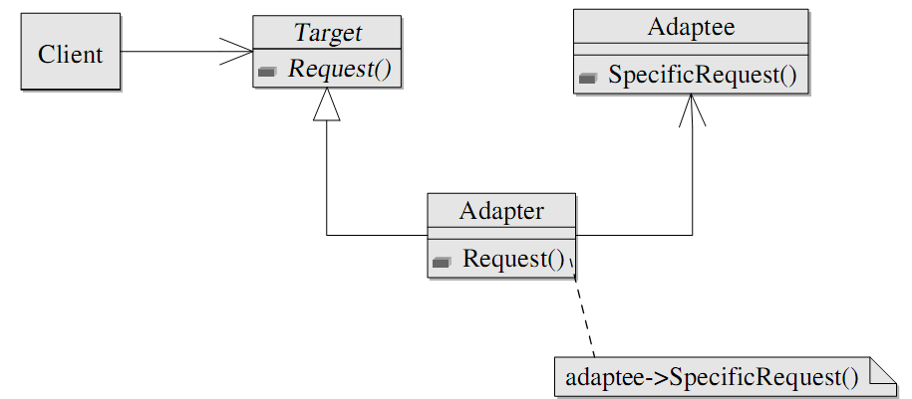
Adapter
Adapter pattern
allows the interface of an existing class to be used from another interface

Slide 16
Adapter
trait StringProvider { def getStringData: String }
val show: StringProvider => Unit
trait Message {// how to show it?
def user: String
def data: String
}
val formatMessage: Message => StringProvider = m =>
new StringProvider {
def getStringData: String = m.user + " said " + m.data
}
val showMessage: Message => Unit =
formatMessage andThen show

Slide 17
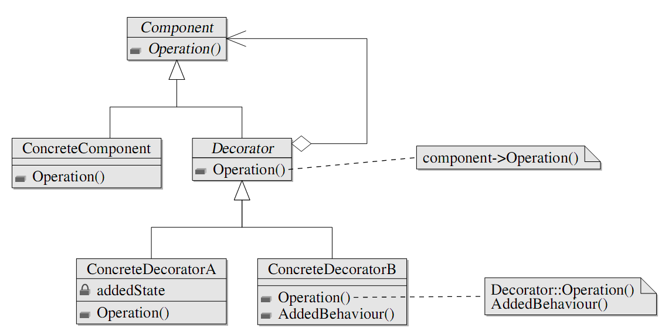
Decorator
Decorator pattern
allows behavior to be added to an individual object
without affecting the behavior of other objects from the same class

Slide 18
Decorator
val fileInputStream: String => FileInputStream = ...
val bufferedInputStream: InputStream => BufferedInputStream = ...
val gzipInputStream: InputStream => GzipInputStream = ...
val objectInputStream: InputStream => ObjectInputStream = ...
val getStream = fileInputStream andThen bufferedInputStream andThen
gzipInputStream andThen objectInputStream
val deserializationStream = getStream("objects.gz")
val obj = deserializationStream.readObject()
deserializiationStream.close()

Slide 19
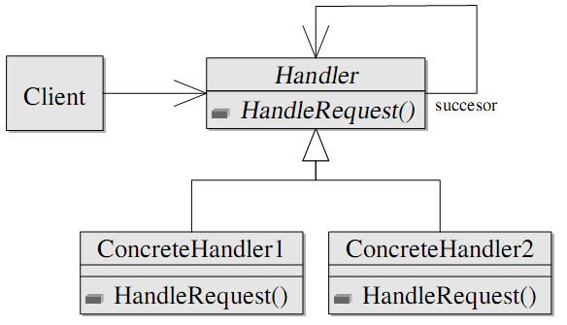
Chain of Responsibility
Chain of responsibility pattern
avoids coupling the sender of a request to its receiver by giving more than one object a chance to handle the request
chains the receiving objects and pass the request along the chain until an object handles it

Slide 20
Chain of Responsibility
val storeEmpty: PartialFunction[String, Unit] =
{ case "" => logger.error("Empty message") }
val storeShort: PartialFunction[String, Unit] =
{ case s if s.length < 256 => writeToDB(s) }
val storeLong: PartialFunction[String, Unit] =
{ case s if s.length >= 256 => writeToDB(compress(s)) }
val storeMessage = storeEmpty orElse storeShort orElse storeLong

Slide 21
OOP
Several Scala design patterns

Slide 22
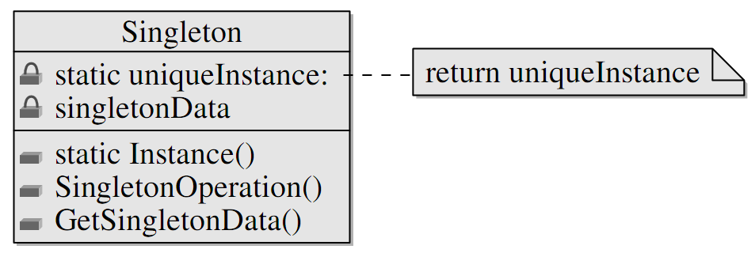
Singleton
Singleton pattern
restricts the instantiation of a class to one object

Slide 23
Singleton
trait Locale {
def getMessage(key: String): String
}
object MessageBox{
def show(message: String): String = ...
def show(messageKey: String, locale: Locale): String =
show(locale.getMessage(messageKey))
}
class ConfigBasedLocale(config: Config) extends Locale{
def getMessage(key: String): String =
// get messages from config
}

Slide 24
Singleton
MessageBox.show(
"FileNotFoundError",
new ConfigBasedLocale("user_defined.conf"))
object English extends ConfigBasedLocale("english.conf")
object French extends ConfigBasedLocale("french.conf")
MessageBox.show("FileNotFoundError", English)
MessageBox.show("FileNotFoundError", French)

Slide 25
Traits
Traits:
are interfaces with non-abstract methods
implement safe multiple inheritance (mixin class composition)
provide a way of declaration of dependencies

Slide 26
Traits
trait Logger {
def log(msg: String): Unit
def logInfo(msg: String) = log("[Info] " + msg)
def logError(msg: String) = log("[Error] " + msg)
}
trait ConsoleLogger extends Logger {
def log(msg: String) { println(msg) }
}
trait FileLogger extends Logger { ... }

Slide 27
Traits
class Account {
self: Logger =>
var balance = 0
def withdraw(amount: Double) {
if (amount > balance) self.logError("Insufficient funds")
else self.logInfo("...")
}
}
class AccountCL extends Account with ConsoleLogger
val acc = new AccountCL

Slide 28
Traits
trait ShowAccount {
self: Account =>
def show = "Balance: " + self.balance
}
val acc1 = new Account with ConsoleLogger with ShowAccount
acc1.show() // ok
val acc2 = new Account with ConsoleLogger
acc2.show() // error

Slide 29
Revisiting Decorator: Stackable Trait Pattern
trait IntQueue {
def get(): Int
def put(x: Int)
}
class BasicIntQueue extends IntQueue {
private val buf = new ArrayBuffer[Int]
def get() = buf.remove(0)
def put(x: Int) { buf += x }
}

Slide 30
Revisiting Decorator: Stackable Trait Pattern
trait Doubling extends IntQueue {
abstract override def put(x: Int) { super.put(2 * x) }
}
trait Incrementing extends IntQueue {
abstract override def put(x: Int) { super.put(x + 1) }
}
val queue1 = new BasicIntQueue with Doubling with Incrementing
queue1.put(10)
queue1.get //22
val queue2 = new BasicIntQueue with Incrementing with Doubling
queue2.put(10)
queue2.get //21

Slide 31
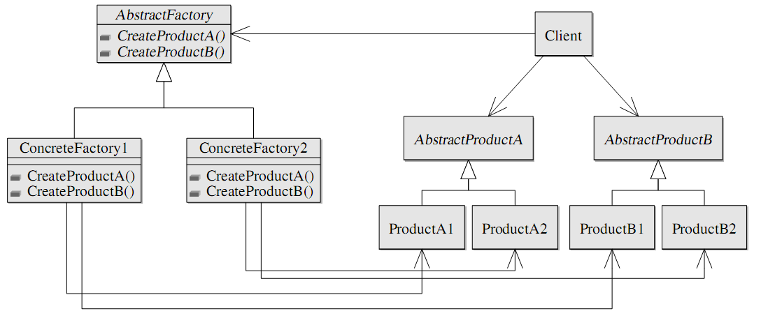
Abstract factory - Family polymorphism
Abstract factory pattern
provides an interface for creating families of related or dependent objects
without specifying the concrete classes

Slide 32
Abstract factory - Family polymorphism
trait WindowFactory{
type aWindow <: Window
type aScrollbar <: Scrollbar
def createWindow(s: aScrollbar): aWindow
def createScrollbar(): aScrollbar
abstract class Window(s: aScrollbar)
abstract class Scrollbar
}

Slide 33
Abstract factory - Family polymorphism
object VistaFactory extends WindowFactory{
type aWindow = VistaWindow
type aScrollbar = VistaScrollbar
def createWindow(s: aScrollbar) = new VistaWindow(s)
def createScrollbar() = new VistaScrollbar
protected class VistaWindow(s:VistaScrollbar) extends Window(s)
protected class VistaScrollbar extends Scrollbar
}
def get(os: String): WindowFactory =
if(os == “vista”) VistaFactory else if …

Slide 34
Abstract factory - Family polymorphism
Advantages of FP:
Impossible to mix products from different factories.
val vista = get(“vista")
val window1: vista.Window =
vista.createWindow(vista.createScrollbar())
val window2 = // type error
vista.createWindow(
get("default").createScrollbar())
Singleton factories are trivial to implement.
Implementation classes are easily hidden from clients.

Slide 35
Dependency Injection - Cake Pattern
Dependency Injection
is pattern that implements inversion of control
is the passing of a dependency (a service) to a dependent object (a client).
Dependency injection involves four elements:
the implementation of a service object
the client object depending on the service
the interface the client uses to communicate with the service
the injector object, which is responsible for injecting the service into the client

Slide 36
Dependency Injection - Cake Pattern
// the first piece of cake
trait NameProviderComponent {
val nameProvider: NameProvider
trait NameProvider { def getName: String }
}
// the second one
trait SayHelloComponent {
val sayHelloService: SayHelloService
trait SayHelloService { def sayHello: Unit }
}
trait Components extends NameProviderComponent
with SayHelloComponent

Slide 37
Dependency Injection - Cake Pattern
trait NameProviderComponentImpl extends NameProviderComponent {
val nameProvider: NameProvider = new NameProviderImpl
private class NameProviderImpl extends NameProvider {
def getName: String = "World"
}}
trait SayHelloComponentImpl extends SayHelloComponent {
self: NameProviderComponent =>
val sayHelloService: SayHelloService = new SayHelloServiceImpl
private class SayHelloServiceImpl extends SayHelloService {
def sayHello: Unit = println("Hello, " + self.nameProvider.getName)
}}

Slide 38
Dependency Injection - Cake Pattern
object MyApplication {
object Components extends Components
with SayHelloComponentImpl
with NameProviderComponentImpl
class Client(c: Components) { def run = c.sayHelloService.sayHello }
def main(args: Array[String]) = new Client(Components).run
// OR
class Client { c: Components => def run = c.sayHelloService.sayHello }
def main(args: Array[String]) =
(new Client with Components with SayHelloComponentImpl
with NameProviderComponentImpl).run }

Slide 39
Dependency Injection - Cake Pattern
Advantages:
Compile-time check: forgotten dependencies break build
The same language is in use
Disadvantage:
Configuration can not be changed in run-time

Slide 40
Dependency Injection - Cake Pattern
Fix (for the first case)
write *.scala configuration file
load & compile it in runtime
from compiled classes select a class which implements Components and instantiate it using reflection
pass created instance to a client

Slide 41
Dependency Injection - Cake Pattern
Fix (for the second case)
Use scala as scripting language: write a simple startup script
val client =
if(test) // command-line parameter val test = argv(0)
new Client extends SayHelloComponent with TestProviderComponent
else
new Client extends SayHelloComponent with NameProviderComponent
client.run
run the script from the command line
scala -cp first.jar:second.jar startupScript.scala true

Slide 42
Value object
Value object
is a small immutable object
that represents a simple entity
whose equality is not based on identity
case class UInt(signed: Int)

Slide 43
Value object
case class Point(x: Int, y: Int, z: Int)
// looks fine
val moveZ = (dz: Int) => (p: Point) => p.copy(z = p.z + dz)
case class Location(room: Room, p: Point)
// there is some code smell
val moveZ = (dz: Int) => (l: Location) =>
l.copy(p = l.p.copy(z = l.p.z + dz))
case class Object(l: Location, weight: Int)
// awful
val moveZ = (dz: Int) => (o: Object) =>
o.copy(l = l.copy(p = l.p.copy(z = l.p.z + dz)))

Slide 44
Lenses
Lenses
generalize properties (i.e. accessors/mutators)
provide a way of “mutation” of immutable objects
class Lens[S, P](get: S => P, set: S => P => S){
val modify: S => (P => P) => S =
(s: S) => (f: P => P) => set(s)(f(get(s)))
def andThen[T](next: Lens[P, T]): Lens[S, T] =
Lens[S, P](s => next.get(this.get(s)),
s => val => this.modify(s)(next.set(_)(val)))
}

Slide 45
Lenses
// There are libraries reducing boilerplate code below
val pointZ = new Lens[Point, Int](
p => p.z, p => v => p.copy(z = v))
val locPoint = new Lens[Location, Point](
l => l.p, l => v => l.copy(p = v))
val objLoc = new Lens[Object, Location](
o => p.l, o => v => o.copy(l = v))
val objZ:Lens[Object,Int]= objLoc andThen locPoint antThen pointZ
val moveZ = (dz: Int) => (o: Object) => objZ.modify(o) { _ + dz }

Slide 46
Benefits of immutability
Why so complex?
immutable objects are easier/simpler to reason about
less state - less area of analysis
removes classes of bugs caused by state
usage as keys of hashtables
objects comparison
wrong order of concurrent access to shared data
removes some design problems
Circle-ellipse problem

Slide 47
Circle-ellipse problem
class Ellipse(xSize: Float, ySize: Float){
var x = xSize
var y = ySize
def stretchX(dx: Float) { x += dx }
def stretchY(dy: Float) { y += dy }
}
class Circle(radius: Float) extends
Ellipse(2 * radius, 2 * radius)
// circle's contract x == y is satisfied
// but could be violated after call of stretchX or stretchY

Slide 48
Circle-ellipse problem
// extensible class hierarchy
class Ellipse(val x: Float, val y: Float){
def stretchX(dx: Float): Ellipse = new Ellipse(x + dx, y)
def stretchY(dy: Float): Ellipse = new Ellipse(x, y + dy)
}
class Circle(val radius: Float) extends
Ellipse(2 * radius, 2 * radius){
def stretch(d: Float): Circle = new Circle(radius + d / 2)
// methods stretchX and stretchY are still available
// but do not return Circles
}
Problem: an ellipse can not become a circle

Slide 49
Circle-ellipse problem
// sealed class hierarchy
sealed class Ellipse(val x: Float, val y: Float)
sealed class Circle(val radius: Float) extends Ellipse(2 * radius, 2 * radius)
def stretchX(e: Ellipse, dx: Float): Ellipse =
if (dx == 0) e
else if (e.x + dx == e.y) new Circle(e.y / 2)
else new Ellipse(e.x + dx, e.y)
def stretchY(e: Ellipse, dy: Float): Ellipse =
if (dy == 0) e
else if (e.y + dy == e.x) new Circle(e.x / 2)
else new Ellipse(e.x, e.y + dy)

Slide 50
Type System
Several Scala design patterns

Slide 51
Simple type-level hack: phantom types
Phantom type
is a parameterized type whose parameters do not all appear on the right-hand side of its definition
types-parameters of phantom-type may never be instantiated
guarantees well-formedness in compile-time

Slide 52
Simple type-level hack: phantom types
trait FlightStatus
trait Flying extends FlightStatus
trait Landed extends FlightStatus
class Plane[Status <: FlightStatus]()
def land(p: Plane[Flying]) = new Plane[Landed]()
def takeOff(p: Plane[Landed]) = new Plane[Flying]()
val plane = new Plane[Landed]()
val flying = takeOff(plane) // ok
val landed = land(flying) // ok
takeOff(flying) // error: type mismatch
land(landed) // error: type mismatch

Slide 53
Missing results
How to represent probably missing result:
null reference?
Null Object pattern?
Impossible value (e.g -1 for index)?
Exception?
Be explicit: use Option in Scala / Optional in Java 8!

Slide 54
Missing results: Option
The Option[T] type uses case classes to express values that might or might not be present:
The case subclass Some[T] wraps a value of type T, for example Some(1) wraps 1 and has type Option[Int]
The case object None indicates that there is no value

Slide 55
Missing results: Option
The methods Option[T].map and Option[T].flatMap
apply a function of type T => R (T => Option[R]) to a value inside Some and produce Option[R], or
skip computation and produce None if an Option instance is None
val address =
request.getParameter("name")
.flatMap(name => db.getUser(name))
.map(user => user.address)

Slide 56
Missing results: Option
Pattern matching or methods get / getOrElse can be used to extract value or react on a missing value.
address match {
case Some(addr) => send(addr, email)
case None => logError(“Unable to send mail”)
}
send(address.getOrElse(deadLettersAddress), email)

Slide 57
Error handling
How to report and handle errors?
Global error variable
<errno.h>
implicit
produce a lot of boilerplate code
Error codes
explicit
produce a lot of boilerplate code
Exceptions
explicit
hard to reason about
produce boilerplate code

Slide 58
Error handling: Try
The Try[T] type is similar to Option[T] but represents values that could be computed with an exception:
Success[T] wraps a value of type T
Failure[Throwable] encapsulates information about a happened error
Special method def Try[T](action: => T): Try[T] wraps an action, executes it and produces a Success[T] if execution was successful, and a Failure otherwise

Slide 59
Error handling: Try
def divide: Try[Int] = {
val dividend =
Try(Console.readLine("Enter an Int that you'd like to divide:\n").toInt)
val divisor =
Try(Console.readLine("Enter an Int that you'd like to divide by:\n").toInt)
dividend.flatMap(x => divisor.map(y => x / y))
}
val x = divide match {
case Success(v) => "Result: " + v
case Failure(e) => "You must've divided by zero or entered something
that's not an Int. Info from the exception: " + e.getMessage
}

Slide 60
Special kinds of computations
computations with probably missing result - Option
computations which may throw exceptions – Try
deferred computations - Future
io-performing actions - IO
any special kind of computation could (and should) be represented in type-level

Slide 61
NOT COVERED TOPICS
Several Scala design patterns

Slide 62
Not covered topics
advanced functional programming (see scalaz)
side-effects control (using Functors, Monads and stacks of Monads)
various functional abstractions (Iteratees, Zippers, etc.)
advanced type-level programming (see shapeless)
polymorphic functions
heterogeneous collections
discriminated unions

Slide 63
Not covered topics
ADT and pattern matching
laziness
immutability (immutable collections, programming without variables) implicit values and conversions
type classes
macro system
DSLs

Slide 64
Not covered topics
Interaction of all these features
For example, using techniques above, ALL the goals of GoF patterns can be achieved
in an object-oriented, but very convenient way, or
in a pure functional way, even without concept of “object”.

Slide 65
QUESTIONS?

Slide 66
THANKS FOR ATTENTION

